Slide 1


Lecture 25: Transformers
NLP Lectures: Part 4 of 4
Harvard IACS
CS109B
Pavlos Protopapas, Mark Glickman, and Chris Tanner

Slide 2
Outline
Recap
Transformers
BERT
GPT-2
Concerns
Summary

Slide 3
Outline
Recap
Transformers
BERT
GPT-2
Concerns
Summary

Slide 4
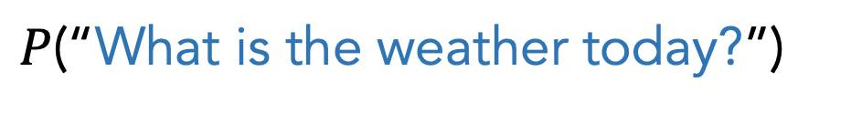
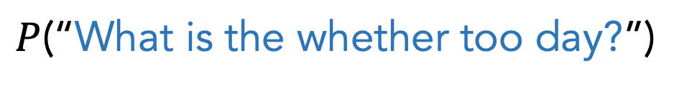
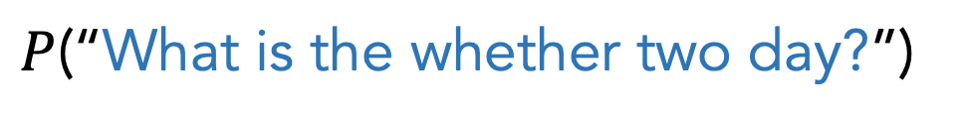
First, we learned about language models (LMs)
$P$(“What is the weather today?”)
$P$(“What is the whether two day?”)
$P$(“What is the whether too day?”)
Being able to correctly estimate the likelihood of sentences is useful for many other tasks

Slide 5
First, we learned about language models (LMs)
Auto-complete
Text Generation
$P$(“What is the weather today?”)
Machine Translation
Text Classification
$P$(“What is the whether two day?”)
Speech Recognition
$P$(“What is the whether too day?”)
Being able to correctly estimate the likelihood of sentences is useful for many other tasks

Slide 6
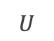
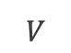


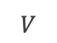
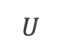
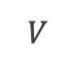


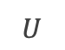

Next, we learned about word embeddings
TYPE-BASED
TOKEN-BASED
a single, global word embedding for each word, independent of its context.
contextualized embeddings are distinct for every occurrence of a word, completely dependent on its context
she
easily
the
test
easily
passed
the
test
$$U$$
$$V$$
$$U$$
$$U$$
$$U$$
$$V$$
$$V$$
$$W$$
$$W$$
$$W$$
$$W$$
passed
she
easily
passed
the
word2vec (skip-gram)
Bidirectional LSTM

Slide 7
Next, we learned about word embeddings
TYPE-BASED
TOKEN-BASED
a single, global word embedding for each word, independent of its context.
These models output embeddings we can save to a file and use however we wish
We then create a separate model that uses these embeddings
Kind of limiting
Often inferior, as of 2015
contextualized embeddings are distinct for every occurrence of a word, completely dependent on its context
she
easily
the
test
easily
passed
the
test
$$U$$
$$V$$
$$U$$
$$U$$
$$U$$
$$V$$
$$V$$
$$W$$
$$W$$
$$W$$
$$W$$
passed
she
easily
passed
the
word2vec (skip-gram)
Bidirectional LSTM

Slide 8
Next, we learned about word embeddings
TYPE-BASED
TOKEN-BASED
These models are trained on a specific task (e.g., LM, text classification, etc)
The hidden layer(s) contains the “meaning” and are very useful
We can extract those embeddings if we wish, or grab the learned weights and re-use for another task
Dominating NLP from 2015 - present
a single, global word embedding for each word, independent of its context.
contextualized embeddings are distinct for every occurrence of a word, completely dependent on its context
she
easily
the
test
easily
passed
the
test
$$U$$
$$V$$
$$U$$
$$U$$
$$U$$
$$V$$
$$V$$
$$W$$
$$W$$
$$W$$
$$W$$
passed
she
easily
passed
the
word2vec (skip-gram)
Bidirectional LSTM

Slide 9
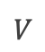
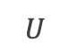
Next, we learned about word embeddings
TYPE-BASED
TOKEN-BASED
a single, global word embedding for each word, independent of its context.
contextualized embeddings are distinct for every occurrence of a word, completely dependent on its context
LSTMs are amazing but ultimately only look at 1 word at a time, sequentially
Sure, they maintain long-term memory, but they are short-sighted in terms of knowing what to hold onto and how to weight each input
she
easily
the
test
passed
$$U$$
$$V$$
$$W$$
passed
easily
word2vec (skip-gram)
Bidirectional LSTM

Slide 10

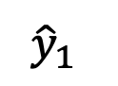
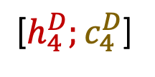
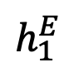
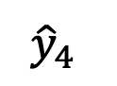
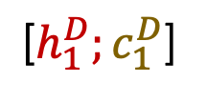
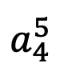
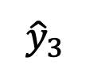
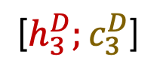
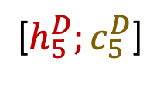
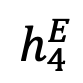
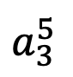
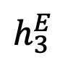
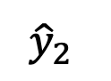
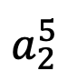
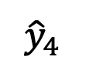
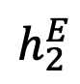
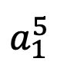
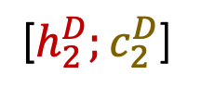
Next, we learned about seq2seq and Attention
$$c_{5}^{D}$$
Le
chien
brun
a
couru
$${\hat{y}}_{1}$$
$${\hat{y}}_{2}$$
$${\hat{y}}_{3}$$
$${\hat{y}}_{4}$$
$${\hat{y}}_{4}$$
$$a_{1}^{5}$$
$$a_{3}^{5}$$
$$a_{4}^{5}$$
$$a_{2}^{5}$$
$$h_{1}^{E}$$
$$h_{2}^{E}$$
$$h_{3}^{E}$$
$$h_{4}^{E}$$
${\text{[}h}_{1}^{D};c_{1}^{D}$]
${\text{[}h}_{2}^{D};c_{2}^{D}$]
${\text{[}h}_{3}^{D};c_{3}^{D}$]
${\text{[}h}_{4}^{D};c_{4}^{D}$]
${\text{[}h}_{5}^{D};c_{5}^{D}$]
Hidden layer
Input layer
The
brown
dog
ran
<s>
Le
chien
brun
a
ENCODER RNN
DECODER RNN

Slide 11
Next, we learned about seq2seq and Attention
$$c_{5}^{D}$$
Le
chien
brun
a
couru
Revolutionary idea
Decoder has access to all input words and appropriately focuses on select parts
It’s conditioned on the current word we’re decoding
$${\hat{y}}_{1}$$
$${\hat{y}}_{2}$$
$${\hat{y}}_{3}$$
$${\hat{y}}_{4}$$
$${\hat{y}}_{4}$$
$$a_{1}^{5}$$
$$a_{3}^{5}$$
$$a_{4}^{5}$$
$$a_{2}^{5}$$
$$h_{1}^{E}$$
$$h_{2}^{E}$$
$$h_{3}^{E}$$
$$h_{4}^{E}$$
${\text{[}h}_{1}^{D};c_{1}^{D}$]
${\text{[}h}_{2}^{D};c_{2}^{D}$]
${\text{[}h}_{3}^{D};c_{3}^{D}$]
${\text{[}h}_{4}^{D};c_{4}^{D}$]
${\text{[}h}_{5}^{D};c_{5}^{D}$]
Hidden layer
Input layer
The
brown
dog
ran
<s>
Le
chien
brun
a
ENCODER RNN
DECODER RNN

Slide 12
Outline
Recap
Transformers
BERT
GPT-2
Concerns
Summary

Slide 13
Outline
Recap
Transformers
BERT
GPT-2
Concerns
Summary

Slide 14
Goals
Each word in a sequence to be transformed into a rich, abstract representation (context embedding) based on the weighted sums of the other words in the same sequence (akin to deep CNN layers)
Inspired by Attention, we want each word to determine, “how much should I be influenced by each of my neighbors”
Want positionality

Slide 15
Self-Attention
z₁
z₂
z₃
z₄
Output representation
Self-Attention’s goal is to create great representations, z_{i}, of the input
??????
Input vectors
The
brown
dog
ran
x₁
x₂
x₃
x₄

Slide 16
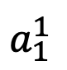
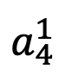
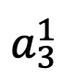
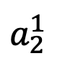
Self-Attention
z₁
Output representation
Self-Attention’s goal is to create great representations, z_{i}, of the input
z₁ will be based on a weighted contribution of x₁, x₂, x₃, x₄
$$a_{1}^{1}$$
$$a_{2}^{1}$$
$$a_{3}^{1}$$
$$a_{4}^{1}$$
Input vectors
The
brown
dog
ran
x₁
x₂
x₃
x₄

Slide 17
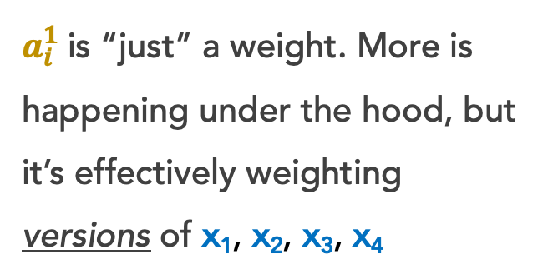
Self-Attention
z₁
Output representation
Self-Attention’s goal is to create great representations, z_{i}, of the input
z₁ will be based on a weighted contribution of x₁, x₂, x₃, x₄
$$a_{1}^{1}$$
$$a_{2}^{1}$$
$$a_{3}^{1}$$
$$a_{4}^{1}$$
$a_{i}^{1}$is “just” a weight. More is happening under the hood, but it’s effectively weighting versions of x₁, x₂, x₃, x₄
Input vectors
The
brown
dog
ran
x₁
x₂
x₃
x₄

Slide 18
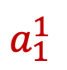
Self-Attention
z₁
Under the hood, each x_{i} has 3 small, associated vectors. For example, x₁ has:
Query q_{i}
Key k_{i}
Value v_{i}
Output representation
$$a_{1}^{1}$$
$$a_{2}^{1}$$
$$a_{3}^{1}$$
$$a_{4}^{1}$$
Input vectors
The
brown
dog
ran
x₁
x₂
x₃
x₄

Slide 19
Self-Attention
Under the hood, each x_{i} has 3 small, associated vectors. For example, x₁ has:
Query q₁
Key k₁
Value v₁
Step 1: Our Self-Attention Head l has just 3 weight matrices W_{q}, W_{k}, W_{v} in total. These same 3 weight matrices are multiplied by each x_{i} to create all vectors:
q_{i} = w_{q} x_{i}
k_{i} = w_{k} x_{i}
v_{i} = w_{v} x_{i}
q₁
k₁
v₁
q₂
k₂
v₂
q₃
k₃
v₃
q₄
k₄
v₄
The
brown
dog
ran
x₁
x₂
x₃
x₄

Slide 20
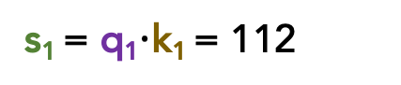
Self-Attention
Step 2: For word x₁, let’s calculate the scores s₁, s₂, s₃, s₄, which represent how much attention to pay to each respective ”word” v_{i}
s₁ = q₁$⋅$k₁ = 112
q₁
k₁
v₁
q₂
k₂
v₂
q₃
k₃
v₃
q₄
k₄
v₄
The
brown
dog
ran
x₁
x₂
x₃
x₄
Notes:
A given word’s query vector should be more similar to word’s key vector than it is to any other word’s key vector.
We take the dot product, so their magnitudes should be higher than the others.
The v vector for each word will likely be similar to the original word vector, since we ultimately weight these vectors, not our original x vectors.

Slide 21
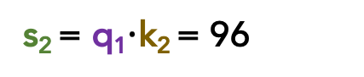
Self-Attention
Step 2: For word x₁, let’s calculate the scores s₁, s₂, s₃, s₄, which represent how much attention to pay to each respective ”word” v_{i}
s₂ = q₁$⋅$k₂ = 96
s₁ = q₁$⋅$k₁ = 112
q₁
k₁
v₁
q₂
k₂
v₂
q₃
k₃
v₃
q₄
k₄
v₄
The
brown
dog
ran
x₁
x₂
x₃
x₄
Notes:
A given word’s query vector should be more similar to word’s key vector than it is to any other word’s key vector.
We take the dot product, so their magnitudes should be higher than the others.
The v vector for each word will likely be similar to the original word vector, since we ultimately weight these vectors, not our original x vectors.

Slide 22
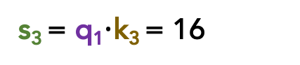
Self-Attention
Step 2: For word x₁, let’s calculate the scores s₁, s₂, s₃, s₄, which represent how much attention to pay to each respective ”word” v_{i}
s₃ = q₁$⋅$k₃ = 16
s₂ = q₁$⋅$k₂ = 96
s₁ = q₁$⋅$k₁ = 112
q₁
k₁
v₁
q₂
k₂
v₂
q₃
k₃
v₃
q₄
k₄
v₄
The
brown
dog
ran
x₁
x₂
x₃
x₄
Notes:
A given word’s query vector should be more similar to word’s key vector than it is to any other word’s key vector.
We take the dot product, so their magnitudes should be higher than the others.
The v vector for each word will likely be similar to the original word vector, since we ultimately weight these vectors, not our original x vectors.

Slide 23
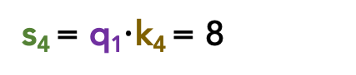
Self-Attention
Step 2: For word x₁, let’s calculate the scores s₁, s₂, s₃, s₄, which represent how much attention to pay to each respective ”word” v_{i}
s₄ = q₁$⋅$k₄ = 8
s₃ = q₁$⋅$k₃ = 16
s₂ = q₁$⋅$k₂ = 96
s₁ = q₁$⋅$k₁ = 112
q₁
k₁
v₁
q₂
k₂
v₂
q₃
k₃
v₃
q₄
k₄
v₄
The
brown
dog
ran
x₁
x₂
x₃
x₄
Notes:
A given word’s query vector should be more similar to word’s key vector than it is to any other word’s key vector.
We take the dot product, so their magnitudes should be higher than the others.
The v vector for each word will likely be similar to the original word vector, since we ultimately weight these vectors, not our original x vectors.

Slide 24
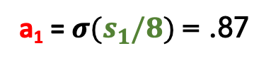
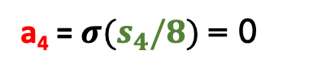
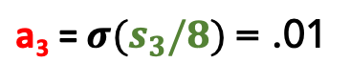
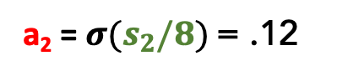
Self-Attention
Step 3: Our scores s₁, s₂, s₃, s₄ don’t sum to 1. Let’s divide by $√len(k_{i})$ and softmax it
s₄ = q₁$⋅$k₄ = 8
a₄ = $σ(s_{4}/8)$ = 0
s₃ = q₁$⋅$k₃ = 16
$\text{a}\text{3}\text{ =} σ(s_{3}/8)$ = .01
s₂ = q₁$⋅$k₂ = 96
a₂ = $σ(s_{2}/8)$ = .12
s₁ = q₁$⋅$k₁ = 112
a₁ = $σ(s_{1}/8)$ = .87
q₁
k₁
v₁
q₂
k₂
v₂
q₃
k₃
v₃
q₄
k₄
v₄
The
brown
dog
ran
x₁
x₂
x₃
x₄
Notes:
We then normalize these attention scores

Slide 25
Self-Attention
Step 3: Our scores s₁, s₂, s₃, s₄ don’t sum to 1. Let’s divide by $√len(k_{i})$ and softmax it
s₄ = q₁$⋅$k₄ = 8
a₄ = $σ(s_{4}/8)$ = 0
Instead of these a_{i} values directly weighting our original x_{i} word vectors, they directly weight our v_{i} vectors.
s₃ = q₁$⋅$k₃ = 16
$\text{a}\text{3}\text{ =} σ(s_{3}/8)$ = .01
s₂ = q₁$⋅$k₂ = 96
a₂ = $σ(s_{2}/8)$ = .12
s₁ = q₁$⋅$k₁ = 112
a₁ = $σ(s_{1}/8)$ = .87
q₁
k₁
v₁
q₂
k₂
v₂
q₃
k₃
v₃
q₄
k₄
v₄
The
brown
dog
ran
x₁
x₂
x₃
x₄

Slide 26
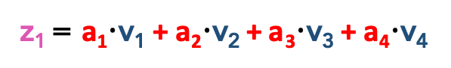
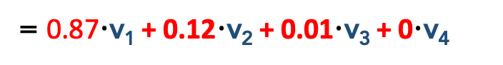
Self-Attention
Step 4: Let’s weight our v_{i} vectors and simply sum them up!
z₁
z₁ = a₁$⋅$v₁ + a₂$⋅$v₂ + a₃$⋅$v₃ + a₄$⋅$v₄
= 0.87$⋅$v₁ + 0.12$⋅$v₂ + 0.01$⋅$v₃ + 0$⋅$v₄
q₁
k₁
v₁
q₂
k₂
v₂
q₃
k₃
v₃
q₄
k₄
v₄
The
brown
dog
ran
x₁
x₂
x₃
x₄

Slide 27
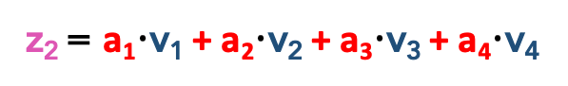
Self-Attention
Step 5: We repeat this for all other words, yielding us with great, new z_{i} representations!
z₂
z₂ = a₁$⋅$v₁ + a₂$⋅$v₂ + a₃$⋅$v₃ + a₄$⋅$v₄
q₁
k₁
v₁
q₂
k₂
v₂
q₃
k₃
v₃
q₄
k₄
v₄
The
brown
dog
ran
x₁
x₂
x₃
x₄

Slide 28
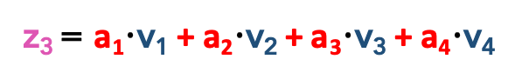
Self-Attention
Step 5: We repeat this for all other words, yielding us with great, new z_{i} representations!
z₃
z₃ = a₁$⋅$v₁ + a₂$⋅$v₂ + a₃$⋅$v₃ + a₄$⋅$v₄
q₁
k₁
v₁
q₂
k₂
v₂
q₃
k₃
v₃
q₄
k₄
v₄
The
brown
dog
ran
x₁
x₂
x₃
x₄

Slide 29
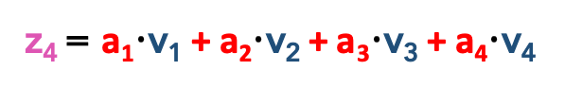
Self-Attention
Step 5: We repeat this for all other words, yielding us with great, new z_{i} representations!
z₄
z₄ = a₁$⋅$v₁ + a₂$⋅$v₂ + a₃$⋅$v₃ + a₄$⋅$v₄
q₁
k₁
v₁
q₂
k₂
v₂
q₃
k₃
v₃
q₄
k₄
v₄
The
brown
dog
ran
x₁
x₂
x₃
x₄

Slide 30
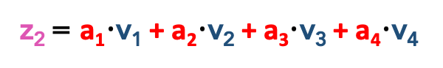
Let’s illustrate another example:
z₂
z₂ = a₁$⋅$v₁ + a₂$⋅$v₂ + a₃$⋅$v₃ + a₄$⋅$v₄
Remember, we use the same 3 weight matrices W_{q}, W_{k}, W_{v} as we did for computing z₁.
This gives us q_{2,} k_{2,} v₂

Slide 31
Self-Attention
Under the hood, each x_{i} has 3 small, associated vectors. For example, x₁ has:
Query q₁
Key k₁
Value v₁
Step 1: Our Self-Attention Head l has just 3 weight matrices W_{q}, W_{k}, W_{v} in total. These same 3 weight matrices are multiplied by each x_{i} to create all vectors:
q_{i} = w_{q} x_{i}
k_{i} = w_{k} x_{i}
v_{i} = w_{v} x_{i}
q₁
k₁
v₁
q₂
k₂
v₂
q₃
k₃
v₃
q₄
k₄
v₄
The
brown
dog
ran
x₁
x₂
x₃
x₄

Slide 32
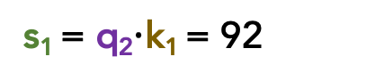
Self-Attention
Step 2: For word x₂, let’s calculate the scores s₁, s₂, s₃, s₄, which represent how much attention to pay to each respective ”word” v_{i}
s₁ = q₂$⋅$k₁ = 92
q₁
k₁
v₁
q₂
k₂
v₂
q₃
k₃
v₃
q₄
k₄
v₄
The
brown
dog
ran
x₁
x₂
x₃
x₄

Slide 33

Self-Attention
Step 2: For word x₂, let’s calculate the scores s₁, s₂, s₃, s₄, which represent how much attention to pay to each respective ”word” v_{i}
s₂ = q₂$⋅$k₂ = 124
s₁ = q₂$⋅$k₁ = 92
q₁
k₁
v₁
q₂
k₂
v₂
q₃
k₃
v₃
q₄
k₄
v₄
The
brown
dog
ran
x₁
x₂
x₃
x₄

Slide 34

Self-Attention
Step 2: For word x₂, let’s calculate the scores s₁, s₂, s₃, s₄, which represent how much attention to pay to each respective ”word” v_{i}
s₃ = q₂$⋅$k₃ = 22
s₂ = q₂$⋅$k₂ = 124
s₁ = q₂$⋅$k₁ = 92
q₁
k₁
v₁
q₂
k₂
v₂
q₃
k₃
v₃
q₄
k₄
v₄
The
brown
dog
ran
x₁
x₂
x₃
x₄

Slide 35

Self-Attention
Step 2: For word x₂, let’s calculate the scores s₁, s₂, s₃, s₄, which represent how much attention to pay to each respective ”word” v_{i}
s₄ = q₂$⋅$k₄ = 8
s₃ = q₂$⋅$k₃ = 22
s₂ = q₂$⋅$k₂ = 124
s₁ = q₂$⋅$k₁ = 92
q₁
k₁
v₁
q₂
k₂
v₂
q₃
k₃
v₃
q₄
k₄
v₄
The
brown
dog
ran
x₁
x₂
x₃
x₄

Slide 36


Self-Attention
Step 3: Our scores s₁, s₂, s₃, s₄ don’t sum to 1. Let’s divide by $√len(k_{i})$ and softmax it
s₄ = q₂$⋅$k₄ = 8
a₄ = $σ(s_{4}/8)$ = 0
s₃ = q₂$⋅$k₃ = 22
$\text{a}\text{3}\text{ =} σ(s_{3}/8)$ = .01
s₂ = q₂$⋅$k₂ = 124
a₂ = $σ(s_{2}/8)$ = .91
s₁ = q₂$⋅$k₁ = 92
a₁ = $σ(s_{1}/8)$ = .08
q₁
k₁
v₁
q₂
k₂
v₂
q₃
k₃
v₃
q₄
k₄
v₄
The
brown
dog
ran
x₁
x₂
x₃
x₄

Slide 37
Self-Attention
Step 3: Our scores s₁, s₂, s₃, s₄ don’t sum to 1. Let’s divide by $√len(k_{i})$ and softmax it
s₄ = q₂$⋅$k₄ = 8
a₄ = $σ(s_{4}/8)$ = 0
Instead of these a_{i} values directly weighting our original x_{i} word vectors, they directly weight our v_{i} vectors.
s₃ = q₂$⋅$k₃ = 22
$\text{a}\text{3}\text{ =} σ(s_{3}/8)$ = .01
s₂ = q₂$⋅$k₂ = 124
a₂ = $σ(s_{2}/8)$ = .91
s₁ = q₂$⋅$k₁ = 92
a₁ = $σ(s_{1}/8)$ = .08
q₁
k₁
v₁
q₂
k₂
v₂
q₃
k₃
v₃
q₄
k₄
v₄
The
brown
dog
ran
x₁
x₂
x₃
x₄

Slide 38


Self-Attention
Step 4: Let’s weight our v_{i} vectors and simply sum them up!
z₂
z₂ = a₁$⋅$v₁ + a₂$⋅$v₂ + a₃$⋅$v₃ + a₄$⋅$v₄
= 0.08$⋅$v₁ + 0.91$⋅$v₂ + 0.01$⋅$v₃ + 0$⋅$v₄
q₁
k₁
v₁
q₂
k₂
v₂
q₃
k₃
v₃
q₄
k₄
v₄
The
brown
dog
ran
x₁
x₂
x₃
x₄

Slide 39
Self-Attention
Tada! Now we have great, new representations z_{i} via a self-attention head
z₁
z₂
z₃
z₄
Self-attention Head
q₁
k₁
v₁
q₂
k₂
v₂
q₃
k₃
v₃
q₄
k₄
v₄
The
brown
dog
ran
x₁
x₂
x₃
x₄

Slide 40
Self-Attention
Tada! Now we have great, new representations z_{i} via a self-attention head
Takeaway:
Self-Attention is powerful; allows us to create great, context-aware representations
z₁
z₂
z₃
z₄
q₁
k₁
v₁
q₂
k₂
v₂
q₃
k₃
v₃
q₄
k₄
v₄
The
brown
dog
ran
x₁
x₂
x₃
x₄

Slide 41
Self-Attention may seem strikingly like Attention in seq2seq models

Slide 42

















$$h_{1}^{D}$$
s₄ =
$${∗h}_{4}^{E}$$
a₄ = $σ(s_{4})$
Attention
s₃ =
$$h_{1}^{D}$$
$${∗h}_{3}^{E}$$
$$\text{a}\text{3}\text{ =} σ(s_{3})$$
$$h_{1}^{D}$$
s₂ =
$${∗h}_{2}^{E}$$
a₂ = $σ(s_{2})$
s₁ =
$$h_{1}^{D}$$
$${∗h}_{1}^{E}$$
a₁ = $σ(s_{1})$
$$h_{1}^{E}$$
$$h_{2}^{E}$$
$$h_{3}^{E}$$
$$h_{4}^{E}$$
$$h_{1}^{D}$$
The
brown
dog
ran
<s>
ENCODER RNN
DECODER RNN

Slide 43

$$h_{1}^{D}$$
s₄ =
$${∗h}_{4}^{E}$$
a₄ = $σ(s_{4})$
Attention
s₃ =
$$h_{1}^{D}$$
$${∗h}_{3}^{E}$$
$$\text{a}\text{3}\text{ =} σ(s_{3})$$
$$h_{1}^{D}$$
s₂ =
$${∗h}_{2}^{E}$$
a₂ = $σ(s_{2})$
s₁ =
$$h_{1}^{D}$$
$${∗h}_{1}^{E}$$
a₁ = $σ(s_{1})$
$$h_{1}^{E}$$
$$h_{2}^{E}$$
$$h_{3}^{E}$$
$$h_{4}^{E}$$
$$h_{1}^{D}$$
We multiply each encoder’s hidden layer by its $a_{i}^{1}$attention weights to create a context vector $c_{1}^{D}$
The
brown
dog
ran
<s>
ENCODER RNN
DECODER RNN

Slide 44

$$h_{1}^{D}$$
s₄ =
$${∗h}_{4}^{E}$$
a₄ = $σ(s_{4})$
Attention
s₃ =
$$h_{1}^{D}$$
$${∗h}_{3}^{E}$$
$$\text{a}\text{3}\text{ =} σ(s_{3})$$
$$h_{1}^{D}$$
s₂ =
$${∗h}_{2}^{E}$$
a₂ = $σ(s_{2})$
s₁ =
$$h_{1}^{D}$$
$${∗h}_{1}^{E}$$
a₁ = $σ(s_{1})$
$$h_{1}^{E}$$
$$h_{2}^{E}$$
$$h_{3}^{E}$$
$$h_{4}^{E}$$
$$h_{1}^{D}$$
We multiply each encoder’s hidden layer by its $a_{i}^{1}$attention weights to create a context vector $c_{1}^{D}$
$c_{1}^{D}$ = a₁$⋅$h₁E + a₂$⋅$ h₂E + a₃$⋅$ h₃E + a₄$⋅$ h₄E
The
brown
dog
ran
<s>
ENCODER RNN
DECODER RNN

Slide 45














s₄ = q₂$⋅$k₄
a₄ = $σ(s_{4}/8)$
Self-Attention
s₃ = q₂$⋅$k₃
$$\text{a}\text{3}\text{ =} σ(s_{3}/8)$$
s₂ = q₂$⋅$k₂
a₂ = $σ(s_{2}/8)$
s₁ = q₂$⋅$k₁
a₁ = $σ(s_{1}/8)$
q₁
k₁
v₁
$$h_{1}^{E}$$
$$h_{2}^{E}$$
$$h_{3}^{E}$$
$$h_{4}^{E}$$
We multiply each word’s value vector by its $a_{i}^{1}$attention weights to create a better vector z₁
z₁ = a₁$⋅$v₁E + a₂$⋅$ v₂E + a₃$⋅$ v₃E + a₄$⋅$ v₄E
The
brown
dog
ran
ENCODER RNN

Slide 46







s₄ = q₂$⋅$k₄
a₄ = $σ(s_{4}/8)$
Self-Attention
Self-Attention
s₃ = q₂$⋅$k₃
Attention
Description
$$\text{a}\text{3}\text{ =} σ(s_{3}/8)$$
s₂ = q₂$⋅$k₂
q_{i}
$$h_{i}^{D}$$
a₂ = $σ(s_{2}/8)$
the probe
s₁ = q₂$⋅$k₁
a₁ = $σ(s_{1}/8)$
k_{i}
$$h_{i}^{E}$$
item being compared
q₁
k₁
v₁
v_{i}
$$h_{i}^{E}$$
item being weighted
We multiply each word’s value vector by its $a_{i}^{1}$attention weights to create a better vector z₁
$$h_{1}^{E}$$
$$h_{2}^{E}$$
$$h_{3}^{E}$$
$$h_{4}^{E}$$
z₁ = a₁$⋅$v₁E + a₂$⋅$ v₂E + a₃$⋅$ v₃E + a₄$⋅$ v₄E
The
brown
dog
ran
ENCODER RNN

Slide 47
s₄ = q₂$⋅$k₄
a₄ = $σ(s_{4}/8)$
Self-Attention
Self-Attention
s₃ = q₂$⋅$k₃
Attention
Description
$$\text{a}\text{3}\text{ =} σ(s_{3}/8)$$
s₂ = q₂$⋅$k₂
q_{i}
$$h_{i}^{D}$$
a₂ = $σ(s_{2}/8)$
the probe
s₁ = q₂$⋅$k₁
a₁ = $σ(s_{1}/8)$
k_{i}
$$h_{i}^{E}$$
item being compared
q₁
k₁
v₁
v_{i}
$$h_{i}^{E}$$
item being weighted
We multiply each word’s value vector by its $a_{i}^{1}$attention weights to create a better vector z₁
$$h_{1}^{E}$$
$$h_{2}^{E}$$
$$h_{3}^{E}$$
$$h_{4}^{E}$$
All of these are like surrogates/proxies/abstractions.
This provides flexibility and fewer constraints. More room for rich abstractions.
z₁ = a₁$⋅$v₁E + a₂$⋅$ v₂E + a₃$⋅$ v₃E + a₄$⋅$ v₄E
The
brown
dog
ran
ENCODER RNN

Slide 48
Self-Attention
Let’s further pass each z_{i} through a FFNN
z₁
z₂
z₃
z₄
Self-attention Head
The
brown
dog
ran
x₁
x₂
x₃
x₄

Slide 49
Self-Attention + FFNN
r₁
r₂
r₃
r₄
Let’s further pass each z_{i} through a FFNN
FFNN
z₁
z₂
z₃
z₄
Self-attention Head
The
brown
dog
ran
x₁
x₂
x₃
x₄
Notes:
We can further add a non-linearity by passing it through a FFNN. It may not seem necessary for now, but soon you’ll see why it’s useful.

Slide 50
Self-Attention + FFNN
r₁
r₂
r₃
r₄
Let’s further pass each z_{i} through a FFNN
We concat w/ a residual connection to help ensure relevant info is getting forward passed.
We perform LayerNorm to stabilize the network and allow for proper gradient flow.
FFNN
+ x₁ Residual Connection +LayerNorm
z₁
z₂
z₃
z₄
Self-attention Head
The
brown
dog
ran
x₁
x₂
x₃
x₄

Slide 51
Self-Attention + FFNN
r₁
r₂
r₃
r₄
Let’s further pass each z_{i} through a FFNN
We concat w/ a residual connection to help ensure relevant info is getting forward passed.
We perform LayerNorm to stabilize the network and allow for proper gradient flow.
Each z_{i} can be computed in parallel, unlike LSTMs!
FFNN
+ x₁ Residual Connection +LayerNorm
z₁
z₂
z₃
z₄
Self-attention Head
The
brown
dog
ran
x₁
x₂
x₃
x₄

Slide 52
Transformer Encoder
r₁
r₂
r₃
r₄
Encoder
Yay! Our r_{i} vectors are our new representations, and this entire process is called a Transformer Encoder
FFNN
+ x₁ Residual Connection +LayerNorm
z₁
z₂
z₃
z₄
Self-attention Head
The
brown
dog
ran
x₁
x₂
x₃
x₄
Notes:
This entire block: the self-attention combined w/ the FFNN is a Transformer Encoder

Slide 53
Transformer Encoder
r₁
r₂
r₃
r₄
Encoder
Yay! Our r_{i} vectors are our new representations, and this entire process is called a Transformer Encoder
Problem: there is no concept of positionality. Words are weighted as if a “bag of words”
FFNN
+ x₁ Residual Connection +LayerNorm
z₁
z₂
z₃
z₄
Self-attention Head
The
brown
dog
ran
x₁
x₂
x₃
x₄

Slide 54

Transformer Encoder
r₁
r₂
r₃
r₄
Encoder
Yay! Our r_{i} vectors are our new representations, and this entire process is called a Transformer Encoder
Problem: there is no concept of positionality. Words are weighted as if a “bag of words”
Solution: append each input word x_{i} with a positional encoding$:\sin\left(i\right)cos⁡(i)$
FFNN
+ x₁ Residual Connection +LayerNorm
z₁
z₂
z₃
z₄
Self-attention Head
The
brown
dog
ran
x₁
x₂
x₃
x₄

Slide 55
A Self-Attention Head has just one set of query/key/value weight matrices w_{q,} w_{k,} w_{v}
Words can relate in many ways, so it’s restrictive to rely on just one Self-Attention Head in the system.
Let’s create Multi-headed Self-Attention

Slide 56
Transformer Encoder
r₁
r₂
r₃
r₄
Encoder
Each Self-Attention Head produces a z_{i} vector.
We can, in parallel, use multiple heads and concat the z_{i}‘s.
FFNN
+ x₁ Residual Connection +LayerNorm
z_{1A}
z_{1B}
z_{1C}
z_{2A}
z_{2B}
z_{2C}
z_{3A}
z_{3B}
z_{3C}
z_{4A}
z_{4B}
z_{4C}
Self-attention Head
The
brown
dog
ran
x₁
x₂
x₃
x₄

Slide 57
Transformer Encoder
r₁
r₂
r₃
r₄
Encoder
To recap: all of this looks fancy, but ultimately it’s just producing a very good contextualized embedding r_{i} of each word x_{i}
FFNN
+ x₁ Residual Connection +LayerNorm
z_{1A}
z_{1B}
z_{1C}
z_{2A}
z_{2B}
z_{2C}
z_{3A}
z_{3B}
z_{3C}
z_{4A}
z_{4B}
z_{4C}
Self-attention Head
The
brown
dog
ran
x₁
x₂
x₃
x₄

Slide 58
Transformer Encoder
To recap: all of this looks fancy, but ultimately it’s just producing a very good contextualized embedding r_{i} of each word x_{i}
r₁
r₂
r₃
r₄
Encoder #1
The
brown
dog
ran
x₁
x₂
x₃
x₄

Slide 59
Transformer Encoder
To recap: all of this looks fancy, but ultimately it’s just producing a very good contextualized embedding r_{i} of each word x_{i}
Why stop with just 1 Transformer Encoder? We could stack several!
r₁
r₂
r₃
r₄
Encoder #1
The
brown
dog
ran
x₁
x₂
x₃
x₄

Slide 60
Transformer Encoder
To recap: all of this looks fancy, but ultimately it’s just producing a very good contextualized embedding r_{i} of each word x_{i}
Why stop with just 1 Transformer Encoder? We could stack several!
r₁
r₂
r₃
r₄
Encoder #3
Encoder #2
Encoder #1
The
brown
dog
ran
x₁
x₂
x₃
x₄

Slide 61
The original Transformer model was intended for Machine Translation, so it had Decoders, too

Slide 62
Transformer Encoders and Decoders
hnědý
pes
běžel
Transformer
Encoder #8
Decoder #8
Transformer Encoders produce contextualized embeddings of each word
Encoder #2
Decoder #2
Transformer Decoders generate new sequences of text
Encoder #1
Decoder #1
The
brown
dog
ran
x₁
x₂
x₃
x₄

Slide 63
Transformer Encoders and Decoders
hnědý
pes
běžel
Transformer
NOTE
Encoder #8
Decoder #8
Transformer Decoders are identical to the Encoders, except they have an additional Attention Head in between the Self-Attention and FFNN layers.
This additional Attention Head focuses on parts of the encoder’s representations.
Encoder #2
Decoder #2
Encoder #1
Decoder #1
The
brown
dog
ran
x₁
x₂
x₃
x₄

Slide 64
Transformer Encoders and Decoders
hnědý
pes
běžel
Transformer
NOTE
Encoder #8
Decoder #8
The query vector for a Transformer Decoder’s Attention Head (not Self-Attention Head) is from the output of the previous decoder layer.
However, the key and value vectors are from the Transformer Encoders’ outputs.
Encoder #2
Decoder #2
Encoder #1
Decoder #1
The
brown
dog
ran
x₁
x₂
x₃
x₄

Slide 65
Transformer Encoders and Decoders
hnědý
pes
běžel
Transformer
NOTE
Encoder #8
Decoder #8
The query, key, and value vectors for a Transformer Decoder’s Self-Attention Head (not Attention Head) are all from the output of the previous decoder layer.
Encoder #2
Decoder #2
Encoder #1
Decoder #1
The
brown
dog
ran
x₁
x₂
x₃
x₄

Slide 66
Transformer Encoders and Decoders
hnědý
pes
běžel
Transformer
IMPORTANT
Encoder #8
Decoder #8
The Transformer Decoders have positional embeddings, too, just like the Encoders.
Critically, each position is only allowed to attend to the previous indices. This masked Attention preserves it as being an auto-regressive LM.
Encoder #2
Decoder #2
Encoder #1
Decoder #1
The
brown
dog
ran
x₁
x₂
x₃
x₄

Slide 67

Loss Function: cross-entropy (predicting translated word)
Training Time: ~4 days on (8) GPUs

Slide 68

Machine Translation results: state-of-the-art (at the time)
:

Slide 69
Machine Translation results: state-of-the-art (at the time)
You can train to translate from Language A to Language B.
Then train it to translate from Language B. to Language C.
Then, without training, it can translate from Language A to Language C

Slide 70
What if we don’t want to decode/translate?
Just want to perform a particular task (e.g., classification)
Want even more robust, flexible, rich representation!
Want positionality to play a more explicit role, while not being restricted to a particular form (e.g., CNNs)

Slide 71
Outline
Recap
Transformers
BERT
GPT-2
Concerns
Summary

Slide 72
Outline
Recap
Transformers
BERT
GPT-2
Concerns
Summary

Slide 73
BERT
Bidirectional Encoder Representations from Transformers

Slide 74
BERT
Bidirectional Encoder Representations from Transformers
Like Bidirectional LSTMs, let’s look in both directions

Slide 75
BERT
Bidirectional Encoder Representations from Transformers
Let’s only use Transformer Encoders, no Decoders

Slide 76
BERT
Bidirectional Encoder Representations from Transformers
It’s a language model that builds rich representations

Slide 77
BERT
brown
lazy
playful
0.92
0.05
0.03
BERT has 2 training objectives:
BERT
1. Predict the Masked word (a la CBOW)
15% of all input words are randomly masked.
80% become [MASK]
10% become revert back
10% become are deliberately corrupted as wrong words
Encoder #8
Encoder #2
Encoder #1
<CLS>
The
brown
dog
x₁
x₂
x₃
x₄

Slide 78
BERT
brown
lazy
playful
0.92
0.05
0.03
BERT has 2 training objectives:
BERT
2. Two sentences are fed in at a time. Predict the if the second sentence of input truly follows the first one or not.
Encoder #8
Encoder #2
Encoder #1
<CLS>
The
brown
dog
x₁
x₂
x₃
x₄

Slide 79

BERT
Every two sentences are separated by a <SEP> token.
50% of the time, the 2nd sentence is a randomly selected sentence from the corpus.
50% of the time, it truly follows the first sentence in the corpus.
Source: original BERT paper: https://arxiv.org/pdf/1810.04805.pdf

Slide 80
BERT
NOTE: BERT also embeds the inputs by their WordPiece embeddings.
WordPiece is a sub-word tokenization learns to merge and use characters based on which pairs maximize the likelihood of the training data if added to the vocab.
Source: original BERT paper: https://arxiv.org/pdf/1810.04805.pdf

Slide 81

BERT
Most of the time, people use BERT to fine-tune on a separate task
Picture: https://jalammar.github.io/illustrated-bert/

Slide 82
BERT
Most of the time, people use BERT to fine-tune on a separate task
y
r₁
r₂
r₃
r₄
Encoder #8
Encoder #1
The
brown
dog
ran
x₁
x₂
x₃
x₄

Slide 83

BERT
Most of the time, people use BERT to fine-tune on a separate task
Picture: https://jalammar.github.io/illustrated-bert/

Slide 84

BERT
Most of the time, people use BERT to fine-tune on a separate task
Picture: https://jalammar.github.io/illustrated-bert/

Slide 85

BERT
One could also extract the contextualized embeddings
Picture: https://jalammar.github.io/illustrated-bert/

Slide 86

BERT
Later layers have the best contextualized embeddings
Picture: https://jalammar.github.io/illustrated-bert/

Slide 87

BERT
BERT yields state-of-the-art (SOTA) results on many tasks
Source: original BERT paper: https://arxiv.org/pdf/1810.04805.pdf

Slide 88
BERT (a Transformer variant)
Takeaway BERT is incredible for learning contextualized embeddings of words and using transfer learning for other tasks (e.g., classification).
Can’t generate new sentences though, due to no decoders.
y
Typically, one uses BERT’s awesome embeddings to fine-tune toward a different NLP task (this is called Sequential Transfer Learning)
r₁
r₂
r₃
r₄
Encoder #8
Encoder #1
The
brown
dog
ran
x₁
x₂
x₃
x₄

Slide 89
Outline
Recap
Transformers
BERT
GPT-2
Concerns
Summary

Slide 90
Outline
Recap
Transformers
BERT
GPT-2
Concerns
Summary

Slide 91
Transformer
What if we want to generate a new output sequence?
GPT-2 model to the rescue!
Generative Pre-trained Transformer 2

Slide 92
GPT-2 (a Transformer variant)
GPT-2 uses only Transformer Decoders (no Encoders) to generate new sequences (from scratch or from a starting sequence)
Oddly, there is no Attention (since there is no Transformer Encoder to attend to). So, there is only Self-Attention.
As it processes each word/token, it cleverly masks the “future” words and conditions itself on the previous words

Slide 93

GPT-2 (a Transformer variant)
As it processes each word/token, it cleverly masks the “future” words and conditions itself on the previous words

Slide 94

GPT-2 (a Transformer variant)
As it processes each word/token, it cleverly masks the “future” words and conditions itself on the previous words

Slide 95
GPT-2 (a Transformer variant)
Technically, it doesn’t use words as input but Byte Pair Encodings (sub-words), similar to BERT’s WordPieces.
Includes positional embeddings as part of the input, too.
Easy to fine-tune on your own dataset (language)

Slide 96
GPT-2 Results
Easy to fine-tune on your own dataset (language)
SYSTEM PROMPT (HUMAN-WRITTEN)
A train carriage containing controlled nuclear materials was stolen in Cincinnati today. Its whereabouts are unknown.
MODEL COMPLETION (MACHINE-WRITTEN, FIRST TRY)
The incident occurred on the downtown train line, which runs from Covington and Ashland stations.
In an email to Ohio news outlets, the U.S. Department of Energy said it is working with the Federal Railroad Administration to find the thief.
“The theft of this nuclear material will have significant negative consequences on public and environmental health, our workforce and the economy of our nation,” said Tom Hicks, the U.S. Energy Secretary, in a statement. “Our top priority is to secure the theft and ensure it doesn’t happen again.”
The stolen material was taken from the University of Cincinnati’s Research Triangle Park nuclear research site, according to a news release from Department officials.
The Nuclear Regulatory Commission did not immediately release any information.

Slide 97

GPT-2 Results

Slide 98

GPT-2 Results

Slide 99
GPT-2
GPT-2 uses only Transformer Decoders (no Encoders) to generate new sequences
As it processes each word/token, it cleverly masks the “future” words and conditions itself on the previous words
Can generate text from scratch or from a starting sequence.
Easy to fine-tune on your own dataset (language)
GPT-3 is an even bigger version of GPT-2, but isn’t open-source
Takeaway: GPT-2 is astounding for generating realistic-looking new text
Can fine-tune toward other tasks, too.

Slide 100
Outline
Recap
Transformers
BERT
GPT-2
Concerns
Summary

Slide 101
Outline
Recap
Transformers
BERT
GPT-2
Concerns
Summary

Slide 102
BERT (a Transformer variant)
BERT is trained on a lot of text data:
BooksCorpus (800M words)
English Wikipedia (2.5B words)
BERT-Base model has 12 transformer blocks, 12 attention heads, 110M parameters!
BERT-Large model has 24 transformer blocks, 16 attention heads, 340M parameters!
Yay, for transfer learning!

Slide 103
GPT-2 (a Transformer variant)
GPT-2 is:
trained on 40GB of text data (8M webpages)!
1.5B parameters
GPT-3 is an even bigger version (175B parameters) of GPT-2, but isn’t open-source
Yay, for transfer learning!

Slide 104

Concerns
There are several issues to be aware of:
It is very costly to train these large models. The companies who develop these models easily spend an entire month training one model, which uses incredible amounts of electricity.
BERT alone is estimated to cost over $1M for their final models
Source: https://arxiv.org/pdf/2004.08900.pdf

Slide 105

Concerns
It is very costly to train these large models.
Source: https://arxiv.org/pdf/2004.08900.pdf

Slide 106
Concerns
Further, these very large language models have been shown to be biased (e.g., in terms of gender, race, sex, etc).
Converting from one language to another often converts gender neutral pronouns to sexist stereotypes
Using these powerful LMs comes with risks of producing such text and/or evaluating/predicting tasks based on these biased assumptions.
People are researching how to improve this

Slide 107
Concerns
As computer-generated text starts to become indistinguishable from authentic, human-generated text, consider the ethical impact of fraudulently claiming text to be from a particular author.
If used maliciously, it can easily contribute toward the problem of Fake News

Slide 108
Outline
Recap
Transformers
BERT
GPT-2
Concerns
Summary

Slide 109
Outline
Recap
Transformers
BERT
GPT-2
Concerns
Summary

Slide 110
Summary
There has been significant NLP progress in the past few years.
Some of the complex models are incredible, but rely on having a lot of data and computational resources (e.g., Transformers)
With all data science and machine learning, it’s best to understand your data and task very well, clean your data, and start with a simple model (instead of jumping to the most complex model)

Slide 111
Summary
NLP is incredibly fun, with infinite number of problems to work on
I’ll teach an NLP course next year (most likely Spring 2022).

Slide 112
Some definitions to remember
Models
N-gram: count statistics; elementary sequence modelling
FFNN: fixed-length context window; not ideal for sequential modelling
(Vanilla) RNN: uses context; fair sequence modelling
LSTM: a variant of an RNN that handles long-range context better
Seq2Seq: maps 1 sequence to another (n→m sequences)
Attention: determines which elements in sequence A pertain to sequence B
Self-Attention: determines which elements to focus on in its own sequence A
Transformers: learns excellent representation, via a seq2seq framework with self-attention and attention
BERT: Transformer Encoders that learn great representations and can be fine-tuned on other tasks
GPT-2: Transformer Decoders that generate realistic text and can be fine-tuned on other tasks

Slide 113
QUESTIONS?

Slide 114
BACKUP SLIDES

Slide 115

Transformer vs CNN vs RNN
Source: https://d2l.ai/chapter_attention-mechanisms/self-attention-and-positional-encoding.html#subsec-cnn-rnn-self-attention

